Slide 1
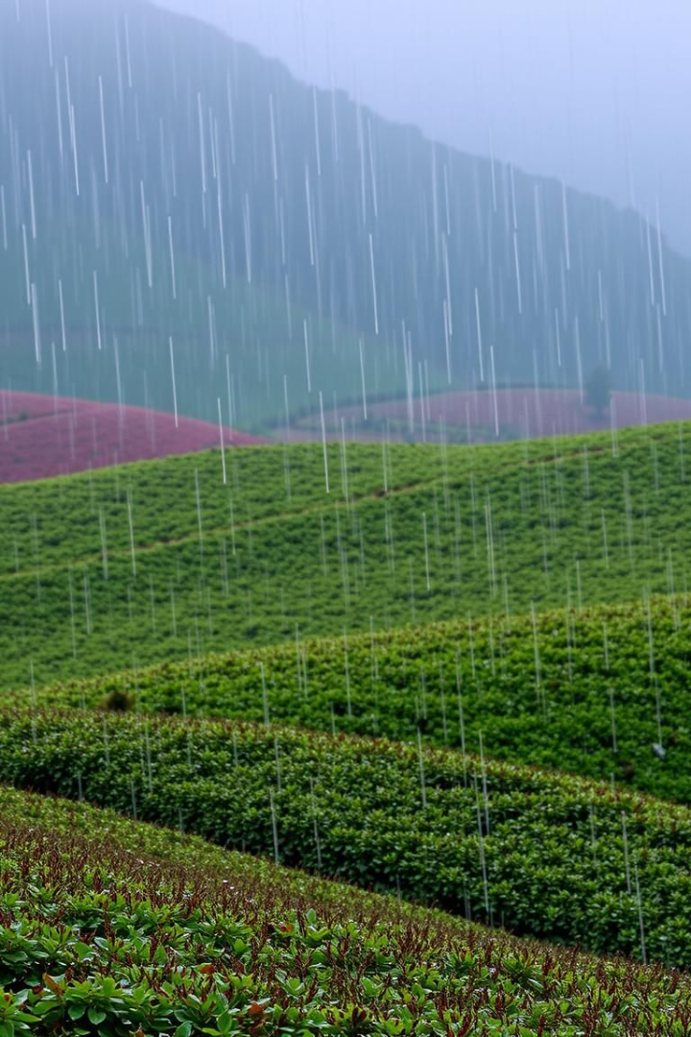
Rainfall Prediction Using Machine Learning
A machine learning approach for weather forecasting. Presented by p Avinash and Mohammad faraan guided by Dr. Sri prasad.
PF
DONE BY:
P Avinash
Mohammad faraan

Slide 2

Introduction: Importance of Rainfall Prediction
Rainfall forecasting is crucial for agriculture, disaster management, and urban planning. Traditional methods struggle with accuracy. Machine learning improves prediction by analyzing historical weather data.
Agriculture
Disaster Management
Optimizing planting and irrigation, preventing crop damage. Accurate forecasts mitigate $40B/year losses globally.
Issuing timely flood and landslide warnings. Early warning systems reduce casualties by up to 80%.
Urban Planning
Designing infrastructure for water resources. Cities save up to 30% in costs through informed planning.

Slide 3

Why Do We Need ML for Rainfall Prediction?
Existing weather models rely on numerical techniques with limitations. Rainfall is influenced by temperature, humidity, and pressure. ML models identify hidden patterns and improve accuracy.
Numerical Limitations
Multiple Factors
Traditional models struggle with non-linear weather interactions and data processing.
Rainfall is influenced by temperature, humidity, pressure, and other variables.
Pattern Identification
ML models can identify hidden patterns and improve prediction accuracy.

Slide 4





Goals of the Project
This project aims to preprocess weather data, train ML models, develop an interactive UI, and evaluate model performance.
Preprocess and clean weather data for accurate predictions.
Train multiple ML models (Logistic Regression, XGBoost, SVC).
Develop an interactive web-based UI for user input and predictions.
Evaluate models based on accuracy and performance metrics.

Slide 5
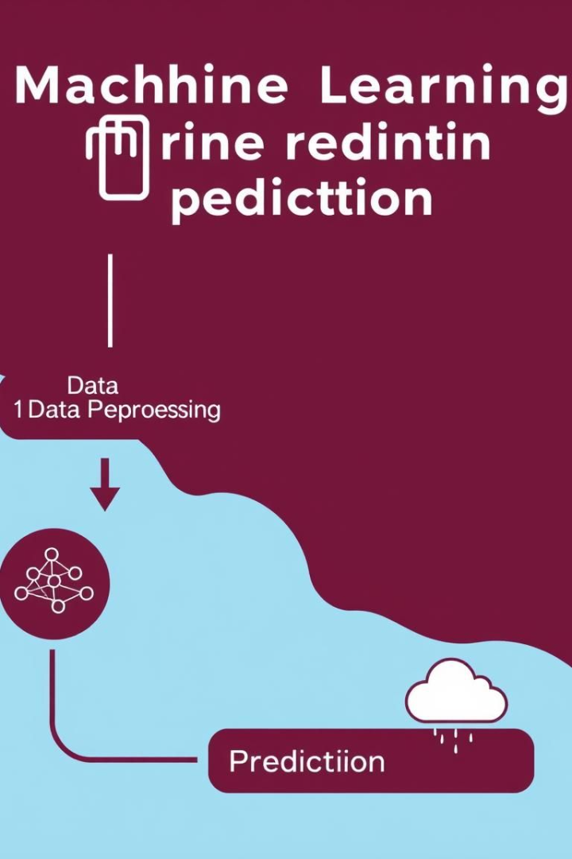




How the System Works
The system preprocesses data, trains ML models, scales features, and provides a user interface for input and predictions.
Data Preprocessing
Handle missing values, normalize data, and encode categorical features.
Model Training
Train ML models: Logistic Regression, XGBoost, SVC.
Feature Scaling
Standardize input features using StandardScaler.
User Interface
Build an interactive web app using Streamlit.

Slide 6
ML Models for Rainfall Prediction
The study uses Logistic Regression, XGBoost, and Support Vector Classifier to predict rainfall. Combining models provides better prediction accuracy.
Logistic Regression
XGBoost
Support Vector Classifier (SVC)
Simple binary classification model for basic predictions.
Advanced boosting algorithm for high accuracy and performance.
Effective for non-linear data separation and complex patterns.

Slide 7




How the System is Structured
The system features a Streamlit-based UI, ML models for processing data, and a preprocessed dataset. It can be hosted locally or on a cloud platform.
Frontend
1
Backend
Streamlit UI for user input.
2
ML models process data.
Deployment
4
Data
3
Local or cloud hosting.
Preprocessed Rainfall.csv.

Slide 8

Evaluating Model Performance
Model performance is evaluated using accuracy, confusion matrix, precision, recall, and AUC-ROC curve. XGBoost achieves the highest accuracy at ~85%.
78%
85%
82%
Logistic Regression Accuracy
XGBoost Accuracy (Best Model)
SVC Accuracy

Slide 9



Where Can This Be Used?
This rainfall prediction system can be used in weather forecasting, agriculture, disaster management, and urban planning for improved decision-making.
Weather Forecasting
More accurate rainfall predictions.
Agriculture
Helps farmers plan irrigation.
Disaster Management
Early flood warnings.

Slide 10
Final Thoughts & Future Enhancements
ML models improve rainfall prediction accuracy, with XGBoost performing best. Future enhancements include real-time data integration and cloud deployment.
Conclusion
Future Enhancements
ML models enhance accuracy.
Integrate real-time data APIs.
XGBoost excels in this study.
Improve deep learning models.
Deploy on cloud platforms.

